Slide 1
Managing Information Technology Resources ITWS 4310
Data, Big Data, and All Things Data
October 18, 2018

Slide 2
Managing IT Resources Class Outline: Thurs, Oct 18, 2018
MITR Term Project
Schedule Meetings with Client and Invite Faculty to Meetings
Work on Design and Development
Draft of Entire Term Project Final Report on Mon Nov 19 by 9 PM
Current Events
Mid-Term Discussion
“Data and Competitive Advantage: Databases, Analytics, AI, and Machine Learning”, Chapter 15 in the Gallaugher Text.
“Big Data: Dimensions, Evolution, Impacts and Challenges” included in the HBS Press Coursepack.

Slide 3
Managing IT Resources Schedule Change
Date | Topics | Preparation | Deliverables
Thu Oct 18 | The Data Asset: DB, DW, BI, the Web of Data. | Read Chapter 15 and other assigned readings | Work on Term Project
Mon Oct 22 | Data, Big Data Lab Exercise | Data, Big Data In-Class Exercise | Submit In-Class Exercise
Thu Oct 25 | Data Analytics | Readings | Work on Term Project
Mon Oct 29 | RPI Infrastructure Tour

Slide 4
Managing IT Resources: ITWS 4310 Term Project Report Outline
Section 1: Executive Summary
Section 2: Introduction
Section 3: Client Organization and Description
Section 4: Project Team
Section 5: Problem Statement
Section 6: IS/IT Solution
Section 7: Methodology
Section 8: IS/IT Requirements
Section 9: IS/IT Design
Section 10: Cost-Benefit Analysis with (Risk Mgmt)
Section 11: Project Plan/Schedule/Resources
Section 12: Post-Turnover Plan
Section 13: Results and Client Feedback
Section 14: Conclusions
All Sections of Final Report in Draft due by Nov 19 (Mon before Thanksgiving) at 9 PM

Slide 5
Technology Current Events: “Tesla’s stock (TSLA) jumps as judge approves settlement of SEC’s complaint against Elon Musk”, Electrek, Oct 16, 2018. https://electrek.co/2018/10/16/tesla-judge-approves-settlement-of-secs-complaint-tsla-elon-musk/
A judge has officially approved the settlement of the SEC’s complaint against Tesla and Elon Musk – making the several punitive actions against the automaker and its CEO official.
Tesla’s stock (TSLA) jumped by 4% on the news.
Some speculated that closing the deal could be an issue after Musk trolled the SEC following the settlement agreement, but a judge has approved it today.
It means that all the terms are now official and will have to be enforced in the next 90 days:
Musk will step down as Tesla’s Chairman and be replaced by an independent Chairman. Musk will be ineligible to be re-elected Chairman for three years;
Tesla will appoint a total of two new independent directors to its board;
Tesla will establish a new committee of independent directors and put in place additional controls and procedures to oversee Musk’s communications;
Musk and Tesla will each pay a separate $20 million penalty. The $40 million in penalties will be distributed to harmed investors under a court-approved process.

Slide 6
Technology Current Events: “Google CEO Sundar Pichai confirms censored China search engine”, Engadget, Oct 16, 2018. https://www.engadget.com/2018/10/16/google-sundar-pichai-china-search-engine/
When Google's chief privacy officer admitted to the Senate that the company is working on a secret project called 'Dragonfly,' he refused to say what it is. According to previous reports, Dragonfly is the codename for the censored search engine Google has been developing for China since 2017 -- a search engine that can automatically identify websites banned by the country's infamous firewall and can remove them from the results page. Now, Google chief Sundar Pichai has openly confirmed the search engine's existence at the Wired 25 Summit and even told the audience that its development is going very well.
"It turns out we'll be able to serve well over 99 percent of the queries," he said on stage. The executive defended the project, telling people that Google is "compelled by [its] mission [to] provide information to everyone," but it also has to follow the laws in every country. China serves as home to 20 percent of the world's population, after all, and its absence in the nation means it's missing out on such a huge number of potential users.
Pichai said that there are many areas where Google could provide "information better than what's available" to people in China. The search engine could lead to reliable cancer treatment info, for instance, instead of the fake information they might be getting elsewhere.
The Google CEO also said during the event that the company re-evaluated its choice to pull out of China a few years ago, calling the country a wonderful and innovative market. "We wanted to learn what it would look like if we were in China, so that's what we built internally," he said. "Given how important the market is and how many users there are, we feel obliged to think hard about this problem and take a longer-term view."

Slide 7
Technology Current Events: “Among the Ruins of Mexico Beach Stands One House, Built ‘for the Big One’”, The New York Times, Oct 14, 2018. https://www.nytimes.com/2018/10/14/us/hurricane-michael-florida-mexico-beach-house.html
As they built their dream house last year on the shimmering sands of the Gulf of Mexico, Russell King and his nephew, Dr. Lebron Lackey, painstakingly documented every detail of the elevated construction, from the 40-foot pilings buried into the ground to the types of screws drilled into the walls. They picked gleaming paints from a palette of shore colors, chose salt-tolerant species to plant in the beach dunes and christened their creation the Sand Palace of Mexico Beach.
“We wanted to build it for the big one,” he said. “We just never knew we’d find the big one so fast.”
The story of how the sand palace made it through Michael while most of its neighbors collapsed is one about building in hurricane-prone Florida, and how construction regulations failed to imagine the Category 4 monster’s catastrophic destruction.
Mr. King wouldn’t say how much he and Dr. Lackey spent to fortify the beachside home, which public records show has been assessed for tax purposes at a value of $400,000. Their architect, Charles A. Gaskin, said that building a house the way they did roughly doubles the cost per square foot, compared with ordinary building practices.

Slide 8
Managing IT Resources Thurs, Oct 18, 2018
Comments and Feedback on Mid-Term Exam

Slide 9
Chapter 15
The Data Asset: Databases, Business Intelligence, analytics, Big Data, and Competitive Advantage

Slide 10
Learning objectives
Understand how increasingly standardized data, access to third-party data sets, cheap, fast computing, and easier-to-use software are collectively enabling a new age of decision making.
Be familiar with some of the enterprises that have benefited from data-driven, fact-based decision making.
That Seat Will Cost You $8−Wait, Make That $45.50
For some games it’s tough to fill the stands. A Wednesday night game against a mediocre rival will prompt thousands to stay home unless they get a really compelling deal. But many fans are ready to pay big bucks for a rivalry game on a weekend. To optimize demand, over thirty teams in Major League Baseball (MLB), the National Basketball Association (NBA), National Hockey League (NHL), and Major League Soccer (MLS) are using data analytics from Austin-based Qcue to fill seats and maximize revenue.

Slide 11
Data and Decision Making
Big data: The collections, storage, and analysis of extremely large, complex, and often unstructured data sets that can be used by organizations to generate insights that would otherwise be impossible to make.
The massive amount of data available to today’s managers.
Unstructured, big, and costly to work through conventional databases.
Made available by new tools for analysis and insight.
Decision making is data-driven, fact-based and enabled by:
Standardized corporate data.
Access to third-party datasets through cheap, fast computing and easier-to-use software.

Slide 12
Data and decision making
Business intelligence (BI):
Analytics:
Machine Learning:

Slide 13
Data and decision making
Business intelligence (BI): Combines aspects of reporting, data exploration and ad hoc queries, and sophisticated data modeling and analysis.
Analytics: Driving decisions and actions through extensive use of:
Data
Statistical and quantitative analysis
Explanatory and predictive models
Fact-based management
Machine Learning: leverages massive amounts of data so that computers can act and improve on their own without additional programming.

Slide 14
Enterprises that Have Benefited from Data Mastery
Data leverage is at the center of competitive advantage in firms such as Amazon, Netflix, and Zara.
Walmart: Moved to the top of the Fortune 500 list.
Encourages firms to make their product the best it possibly can
Data-driven insights are credited with helping politicians win elections.
Sports
Moneyball
Baseball shifts

Slide 15
Learning objectives
Understand the difference between data and information.
Know the key terms and technologies associated with data organization and management.
A Simplified Relational Database for a
University Course Registration System

Slide 16
Learning objectives
Understand various internal and external sources for enterprise data.
Recognize the function and role of data aggregators, the potential for leveraging third-party data, the strategic implications of relying on externally purchased data, and key issues associated with aggregators and firms that leverage externally sourced data.

Slide 17
Transaction Processing Systems
Record a transaction or some form of business-related exchange, such as a cash register sale, ATM withdrawal, or product return
Transaction: Any kind of business exchange.
Loyalty card: System that provides rewards in exchange for consumers, allowing tracking and recording of their activities.
Enhances data collection and represents a significant switching cost.

Slide 18
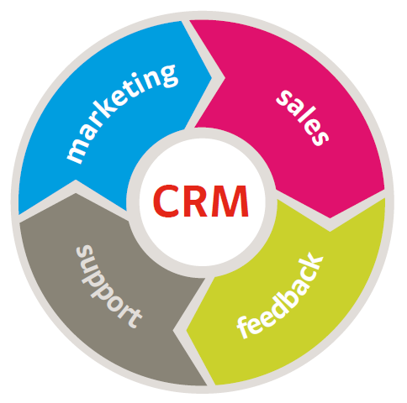
Enterprise Software
Firms set up systems to gather additional data beyond conventional purchase transactions or Website monitoring.
Customer relationship management systems (CRM) - Empower employees to track and record data at nearly every point of customer contact.
Includes other aspects that touch every aspect of the value chain, including SCM and ERP.

Slide 19
Data Aggregators
Firms that collect and resell data
One has to be aware of the digital tracking of individuals.
Made possible by the availability of personal information online.

Slide 20
Learning objectives
Know and be able to list the reasons why many organizations have data that can’t be converted to actionable information.
Understand why transactional databases can’t always be queried and what needs to be done to facilitate effective data use for analytics and business intelligence.
Recognize key issues surrounding data and privacy legislation.

Slide 21
Reasons for Poor Information
Incompatible systems:
Legacy systems: Older information systems that are incompatible with other systems, technologies, and ways of conducting business.
Operational data cannot always be queried:
Most transactional databases are not set up to be simultaneously accessed for reporting and analysis.
Database analysis requires significant processing.

Slide 22
Learning objectives
Understand what data warehouses and data marts are and the purpose they serve.
Know the issues that need to be addressed in order to design, develop, deploy, and maintain data warehouses and data marts.
Recognize and understand technologies behind “Big Data,” how they differ from conventional data management approaches, and how they are currently being used for organizational benefit.

Slide 23

Data Warehouses and Data Marts
Marts and warehouses may contain huge volumes of data.
Building large data warehouses can be expensive and time consuming.
Large-scale data analytics projects should build on visions with business-focused objectives.

Slide 24
Data Warehouses
Data warehouse is a repository of historical data organized by subject to support decision makers in the organization and include:
Online Analytical Processing (OLAP) which involves the analysis of accumulated data by end users;
Multidimensional data structure which allows data to be represented in a three-dimensional matrix (or data cube).

Slide 25
Data Life Cycle Process

Slide 26
Data Warehouse Benefits
Benefits of a data warehouse:
“One version of the Truth”
Visibility for quality, info sharing, and collaboration
The ability to reach data quickly, since they are located in one place
The ability to reach data easily and frequently by end users with Web browsers.
End users can conduct extensive analysis with data in ways that may not have been possible before.
End users have a consolidated view of organizational data

Slide 27
Data Warehouse Characteristics
Organization Data are organized by subject
Consistency Warehouse data is coded in a consistent manner.
Time variant. The data are kept for many years so they can be used for trends, forecasting, and comparisons over time.
Nonvolatile. Once in the warehouse, data are not updated.
Client/server. The data warehouse uses the client/server architecture mainly to provide end users easy access to data.
Web-based. Data warehouses are designed to provide an efficient computing environment for Web-based applications
Integration. Data from various data sources is integrated.
Real-Time. Although most data warehouses are not real-time, it is becoming possible to accomplish this.

Slide 28
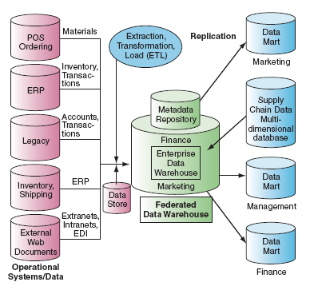
The Data Warehouse Framework

Slide 29
Data Mart Benefits
A data mart is a subset of a data warehouse designed for a strategic business unit (SBU) or a department. Since they contain less information than the entire data warehouse, data marts provide more rapid response and are more easily navigated than enterprise-wide data warehouses.
Data marts can also be an effective means to provide security and can be structured to the specific needs of a department.

Slide 30
Learning objectives
Know the tools that are available to turn data into information.
Identify the key areas where businesses leverage data mining.
Understand some of the conditions under which analytical models can fail.
Recognize major categories of artificial intelligence and understand how organizations are leveraging this technology.

Slide 31
Data mining
Using computers to identify hidden patterns in large data sets and to build models from this data
Models based on:
Customer segmentation and market basket analysis.
Marketing and promotion targeting.
Collaborative filtering and customer churn.
Fraud detection, financial modeling, hiring and promotion.
Prerequisites
Organization must have clean, consistent data.
Events in that data should reflect trends.

Slide 32
ARTIFICIAL INTELLIGENCE
Computer software that seeks to reproduce or mimic human thought, decision making, or brain functions
Data mining has its roots in AI.
Neural network: Examines data and hunts down and exposes patterns, in order to build models to exploit findings.
Expert systems: Leverages rules or examples to perform a task in a way that mimics applied human expertise.
Genetic algorithms: Model building techniques where computers examine many potential solutions to a problem.
Modifies various mathematical models that have to be searched for a best alternative.

Slide 33
Machine learning
Leverages massive amounts of data so that computers can act and improve on their own without additional programming
Neural networks and other types of AI play a role in machine learning, but what’s special is that computers themselves examine data, find insights, and improve.
Example:
Self-driving car

Slide 34
Big Data: Dimensions, Evolution, Impacts and Challenges
What are the Dimensions of Big Data?

Slide 35
Big Data: Dimensions, Evolution, Impacts and Challenges
What are the Dimensions of Big Data?
Volume
Velocity
Variety
Veracity
Variability and Complexity
Value and Decay in Value

Slide 36
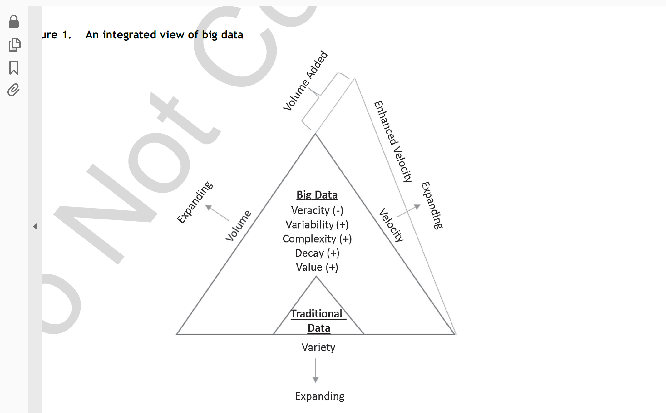
Big Data: Dimensions, Evolution, Impacts and Challenges

Slide 37
Big Data: Dimensions, Evolution, Impacts and Challenges
What has been the Evolution of Big Data?

Slide 38
Big Data: Dimensions, Evolution, Impacts and Challenges
What has been the Evolution of Big Data?
Big Data 1.0 (1994 – 2004)
E-Commerce
Big Data 2.0 (2005 – 2015)
Social Media
Big Data 3.0 (2016 – and on)
Internet of Things (IoT)

Slide 39
Big Data: Dimensions, Evolution, Impacts and Challenges
What are the Impacts of Big Data?

Slide 40
Big Data: Dimensions, Evolution, Impacts and Challenges
What are the Impacts of Big Data?
Personalization Marketing
Better Pricing
Cost Reduction
Improved Customer Service

Slide 41
Big Data: Dimensions, Evolution, Impacts and Challenges
What are the Challenges of Big Data?

Slide 42
Big Data: Dimensions, Evolution, Impacts and Challenges
What are the Challenges of Big Data?
Data Quality
Data Security
Privacy
Investment Justification
Data Management
Shortage of Qualified Data Scientists

